Slide 1


Can We Know?
lesson 2

Slide 2
EVOLUTION or
CREATION?
Why do some believe in evolution?
Does it make any difference?
Can we really know which is true?
All verses are from the NKJV unless noted.

Slide 3
Can We Really Know?
Debate Is NOT Faith Versus Science
  Evolution is based on unobservable assumptions:
    Current processes were constant throughout time
    From nothing came something
    From non-living material came life
    From unintelligent material came intelligence
    Time, chance, and random processes
    =our amazing universe!
Chance
Millions of years
RANDOM
PROCESSES
Life’s Blender

Slide 4

4 For the word of the LORD is right, And all His work is done in truth.
5 He loves righteousness and justice; The earth is full of the goodness of the LORD.
6 By the word of the LORD the heavens were made, And all the host of them by the breath of His mouth.
7 He gathers the waters of the sea together as a heap; He lays up the deep in storehouses.
8 Let all the earth fear the LORD; Let all the inhabitants of the world stand in awe of Him.
9 For He spoke, and it was done;
He commanded, and it stood fast.
Psalm 33

Slide 5
Can We Really Know?
Debate Is NOT Faith Versus Science
  Real science: testable, observational, and repeatable!
  No evolutionist observed the early conditions of the earth (Job 38:4)
    Cannot claim how the first cells were formed?
A matter of faith either way
  What is reasonable faith versus what is absurd faith?

Slide 6
Faith Bridges Gap
?
John 10:38
Sound
Evidences
Conclusion
Uncertainty
Certainty
FAITH

Slide 7

Where Good Evidence Is Wanting
Assumes Law of Biogenesis has not always been true
Unsatisfactory way to explain the presence of life, laws, intelligence, information, etc.
A fossil record without “clear” transitional life-forms

Slide 8
Where Good Evidence Is Contradicting
The presence of “living fossils”
Polystrate fossils
Fossils that deny “millions of years”

Slide 9
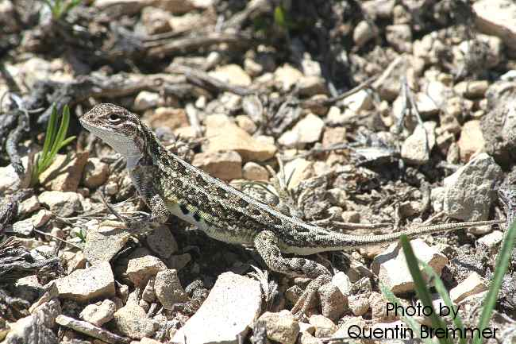

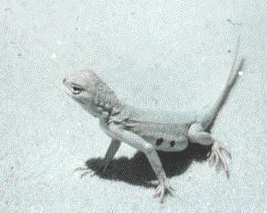
Evidence For Evolution or Creation?
Bleached Earless Lizard
White Sands, New Mexico Form
Typical Form
Genetic Potential (Natural Selection)

Slide 10
“Although some dune-field animals are lighter colored than individuals in other populations of the same species, most animals that live in the dunes are not unusually colored. Among insects, for example, Stroud (1950) notes that ‘the absence of adaptation to the soil color is more striking than its presence.’ He collected 343 insect species at eight different collecting sites within the dunes, and only four of those species were lighter colored than expected (Table 1).Similarly, Blair (1943) trapped twenty-three different species of mammals in the dunes, and only three were lighter colored than expected (Table 1). ”
http://www.nps.gov/whsa/naturescience/white-animals-at-white-sands.htm

Slide 11
Evidence For Creation
Observed fixity of kinds (Gen. 1:11, 12, 21, 24, 25)
Bleached Earless Lizard
White Sands, New Mexico Form
Typical Form
Still a lizard (obeys the Genesis 1 law of fixed kinds)
“Natural Selection” only works with info. present
in population’s genetic pool; no new info. created

Slide 12
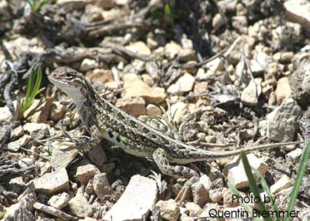
 |  | FATHER
 |  | AB | Ab | aB | ab
MOTHER | AB | AABB | ABAb | ABaB | ABab
 | Ab | AABb | AAbb | AaBb | Aabb
 | aB | aABB | AaBb | aaBB | aaBb
 | ab | AaBb | Aabb | aaBb | aabb
 | AB=DARK
 | ab=LIGHT
If a group becomes isolated with only “ab” information, supplied, then all offspring would become “bleached”

Slide 13
Natural Selection Hijacked by Atheists
“Many people give credit to Charles Darwin for formulating the theory of natural selection as described in his book On the Origin of Species. Few realize that Darwin only popularized the idea and actually borrowed it from several other people, especially a creationist by the name of Edward Blyth. Blyth published several articles describing the process of natural selection in Magazine of Natural History between 1835 and 1837—a full 22 years before Darwin published his book. It is also known that Darwin had copies of these magazines and that parts of On The Origin of Species are nearly verbatim from Blyth’s articles.^{7”}
Purdom, Georgia, 2008, Is Natural Selection the Same Thing as Evolution? http://www.answersingenesis.org/articles/nab/is-natural-selection-evolution

Slide 14
Evidence For Creation
Observed fixity of kinds (Gen. 1:11, 12, 21, 24, 25)
Law of Biogenesis (Acts 17:25, 28)

Slide 15
Quoted From: "Biology Online"
LAW OF BIOGENESIS DEFINED
(1) The process in which life forms arise from similar life forms.
(2) It asserts that living things can only be produced by another living thing, and not by a non-living thing.
Supplement
It is now a common notion that any living thing can only come from another living thing, and no cellular life has ever been observed to arise from non-living matter. For example, a spider lays eggs that will develop into spiders.
http://www.biology-online.org/dictionary/Biogenesis

Slide 16
But the General Theory of Evolution assumes that cellular life did arise from non-living matter a long time ago?
“…no cellular life has ever been observed to arise from non-living matter….”
Christians are not the only ones who believe in unseen things!

Slide 17
Evidence For Creation
Observed fixity of kinds (Gen. 1:11, 12, 21, 24, 25)
Law of Biogenesis (Acts 17:25, 28)
Geological anomalies (Ps. 104:6-9, ASV)

Slide 18
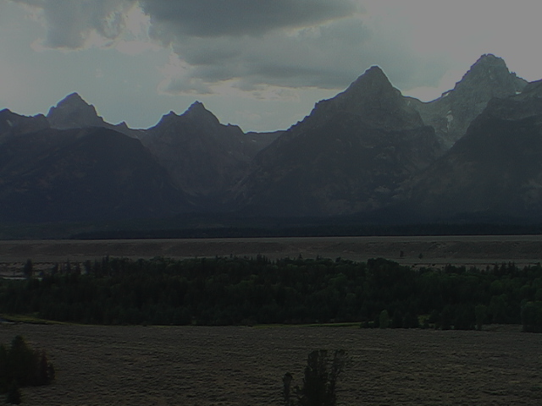
Psalms Tied To The Genesis Flood
6 you covered it with the deep as with a garment; the waters were standing above the mountains.
7 at your rebuke they fled, at the sound of your thunder they hurried away.
8 the mountains rose; the valleys sank down to the place which you established for them.
9 you set a boundary that they may not pass over, so that they will not return to cover the earth”
(Ps. 104:6-9, NASB)

Slide 19
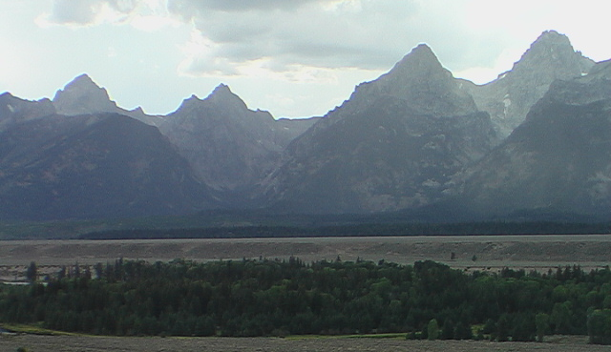

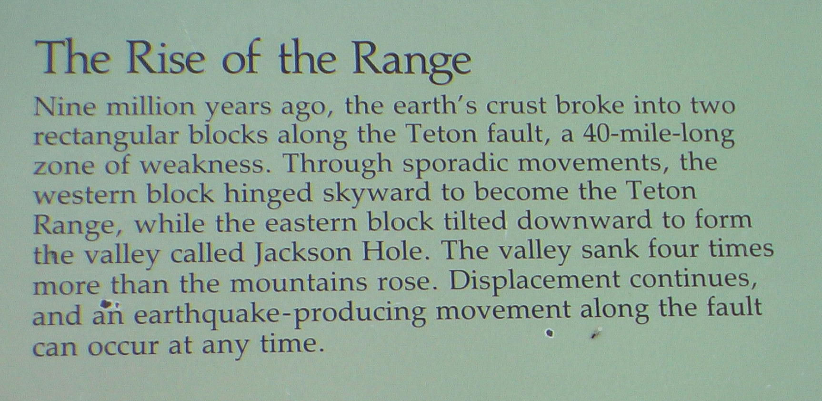
Photo of Sign: Grand Teton National Park

Slide 20
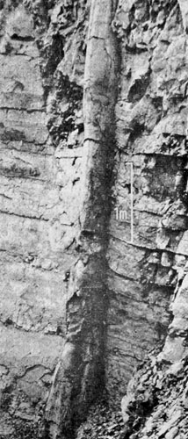
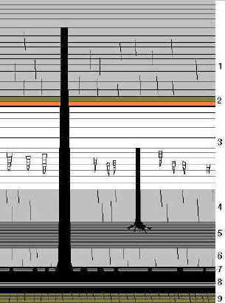
Geologic "Anomalies"
DENY LONG AGES
Polystrate fossils
http://www.earthage.org/polystrate/Fossil%20Trees%20of%20Nova%20Scotia.htm

Slide 21
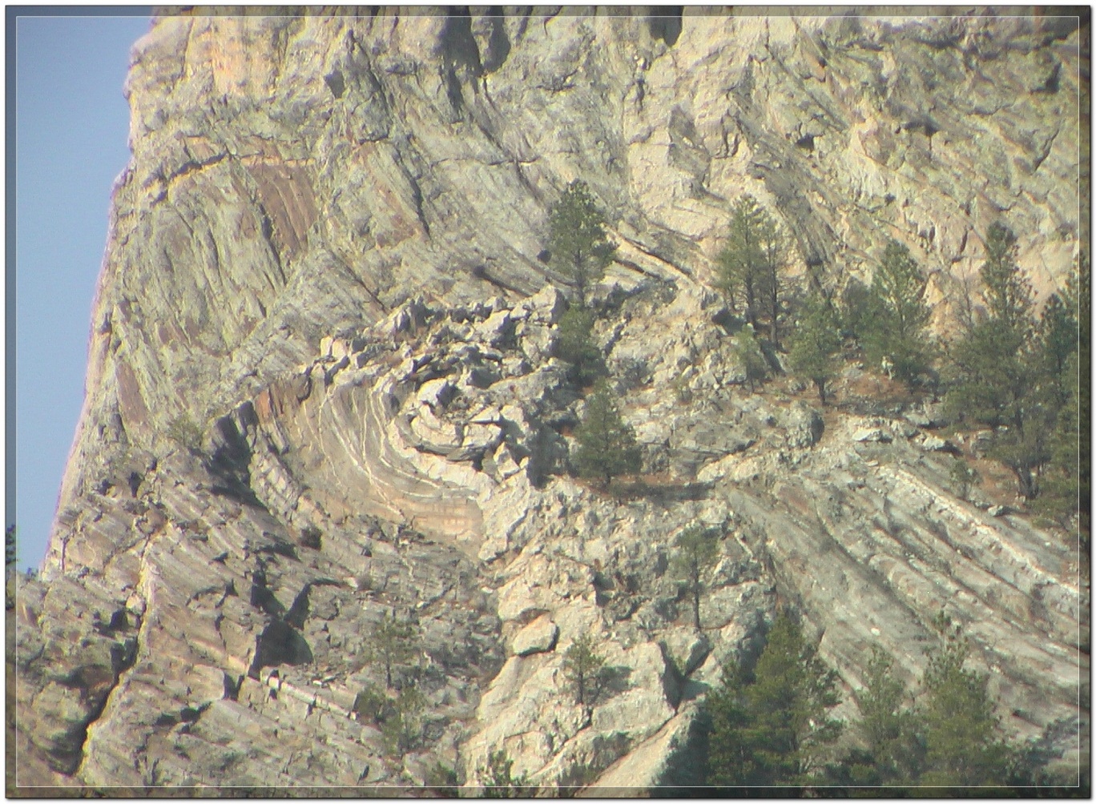
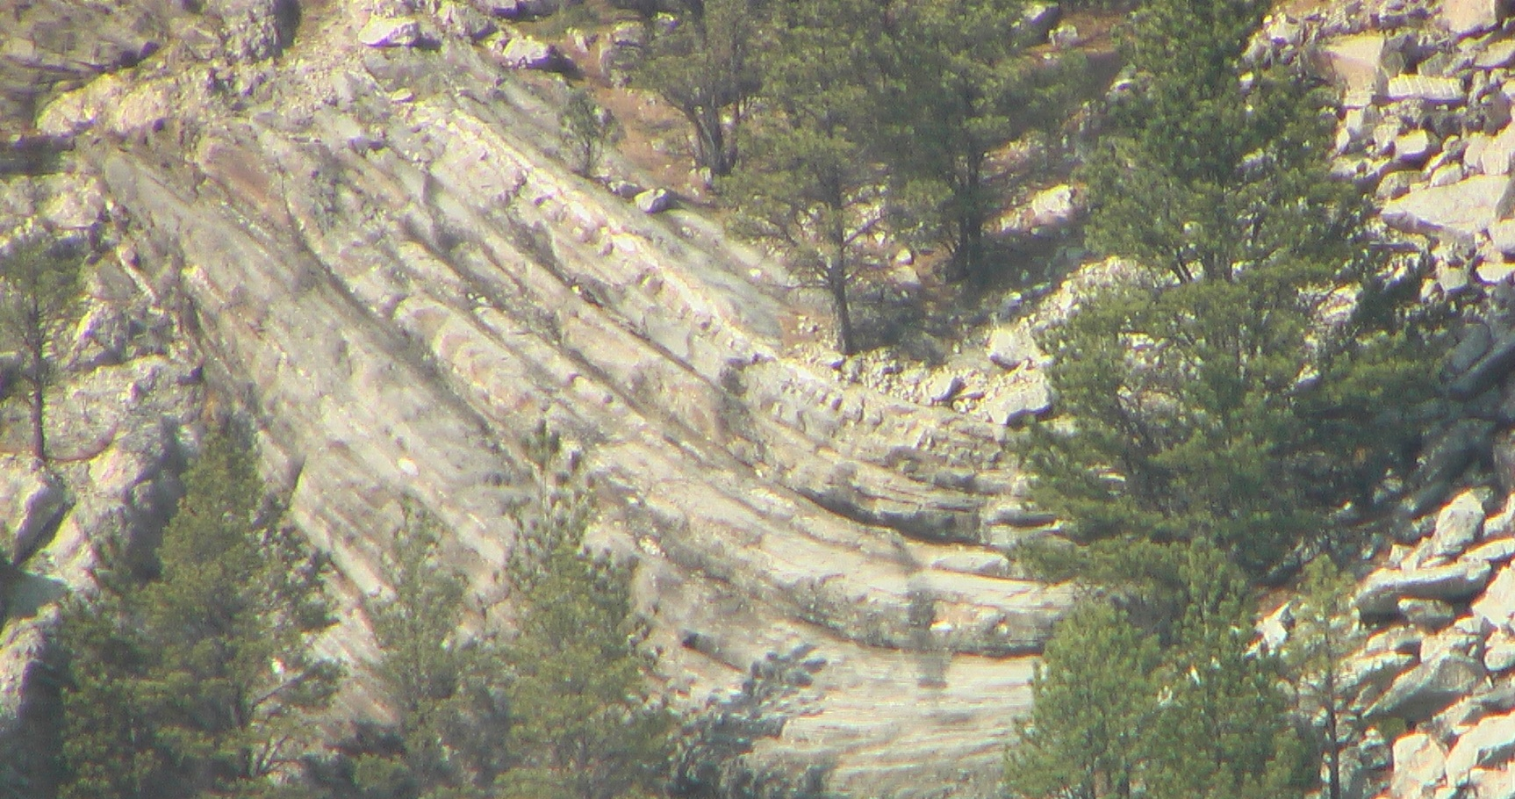
Geologic "Anomalies"
DENY LONG AGES
Polystrate fossils
Bent rock layers without fracturing

Slide 22
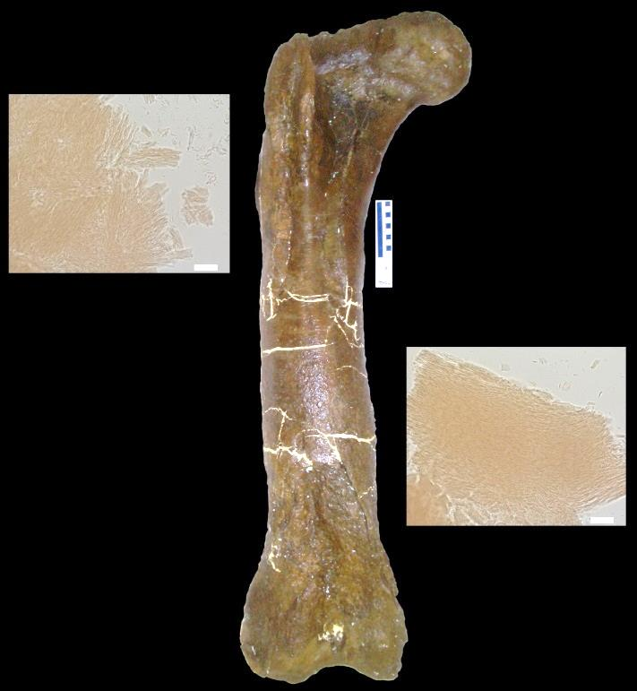
Geologic "Anomalies"
DENY LONG AGES
Polystrate fossils
Bent rock layers without fracturing
Soft and stretchy tissue with
red blood cells found in dinosaur femur (2005, see ww.nbcnews.com/id/7285683/#.UaZ9WkA6On8)
  Difficult to reconcile such with 70 million years
  Evolutionists do not discard their paradigm, but reject the evidence’s implication and modify their paradigm

Slide 23
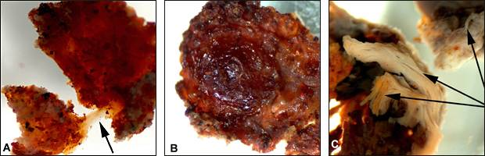
Dinosaur soft tissue
  “it was exactly like looking at a slice of modern bone. But, of course, I couldn’t believe it. . . . The bones, after all, are 65 million years old. How could blood cells survive that long?” (Dr. Mary Schweitzer, http://www.youtube.com/watch?v=XEtL6XjRqMg)
Science via AP
(From www.msnbc.msn.com/id/7285683/)

Slide 24
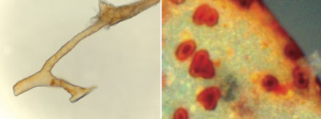
Left: The flexible branching structures in the T. rex bone were justifiably identified as ‘blood vessels’. Soft tissues like blood vessels should not be there if the bones were 65 million years old.
Right: These microscopic structures were able to be squeezed out of some of the blood vessels, and can be seen to ‘look like cells’ as the researchers said. So once again there is scope for Dr Schweitzer to ask the same question, ‘How could these cells last for 65 million years?’
CREDIT: M. H. Schweitzer
by Dr Carl Wieland, CMI–Australia
http://creation.com/still-soft-and-stretchy

Slide 25
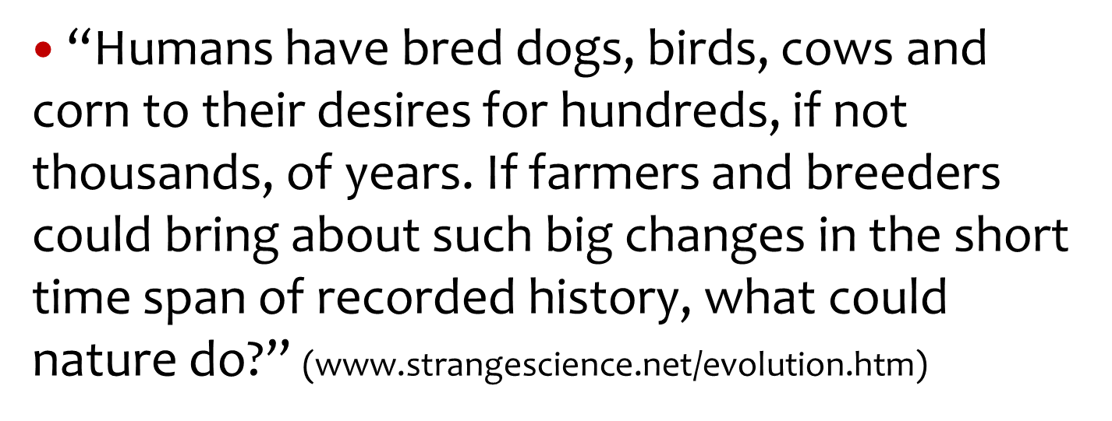
Geologic "Anomalies"
DENY LONG AGES
Polystrate fossils
Bent rock layers without fracturing
Soft and stretchy tissue with red
blood cells found in dinosaur femur
Living fossils
Remember…

Slide 26
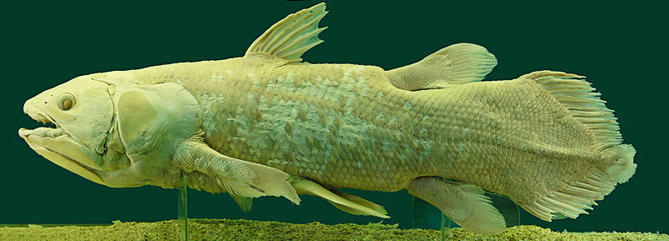
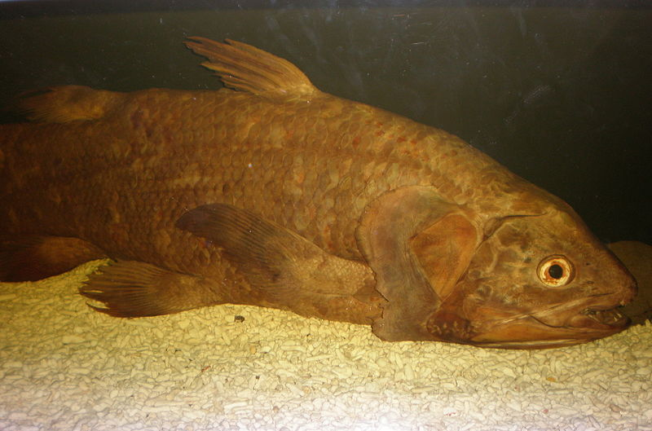
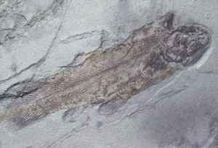
Dated as living 400 million years ago; extinct 65 million years ago
“…coelacanths were considered to be transitional species between fish and tetrapods” (http://en.wikipedia.org/wiki/Coelacanth)
http://en.wikipedia.org/wiki/File:Latimeria_Chalumnae_-_Coelacanth_-_NHMW.jpg
WHY NO CHANGE IN FOSSIL RECORD?
“The coelacanths were thought to have gone extinct 65 million years ago, until a living specimen belonging to the order was discovered in 1938” (http://en.wikipedia.org/wiki/Living_fossil)

Slide 27
Evidence For Creation
Observed fixity of kinds (Gen. 1:11, 12, 21, 24, 25)
Law of Biogenesis (Acts 17:25, 28)
Geological anomalies (Ps. 104:6-9, ASV)
Jesus And The Bible (Gen. 1, 2; Mk. 10:6; Jn. 1:1-3; Matt. 24:35)
  The executing eye-witness and testifier of creation!
“You are worthy, O Lord, To receive glory and honor and power; For You created all things, And by Your will they exist and were created.”
Revelation 4:11

Slide 28
THE PLAN FOR
YOUR SALVATION
Hear the Word of God---Rom. 10:17
Believing In Your Heart---Heb. 11:6
Repenting Of Your Sins---Acts 2:38
Confess That Christ Is The Son of God--- Rom. 10:10; Acts 8:37
Be Baptized Into Christ---Gal. 3:26-29
Be Faithful Until Death---Rev. 2:10; I Cor. 15:58

